Slide 1

Binary Search Trees: Introduction
Saif Hassan
Department of Computer Science
Sukkur IBA University
Data Structures
Data Structures and Algorithms
Notes:
1

Slide 2
Agenda
Local Search
Examples
Notes:
<number>

Slide 3
Learning Objectives
Provide examples of the sorts of problems we hope to solve with Binary Search Trees.
Show why data structures that we have already covered are insufficient.

Slide 4
Agenda
Local Search
Examples
Notes:
<number>

Slide 5
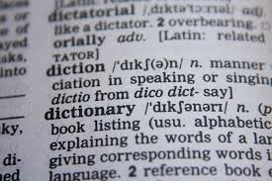
Dictionary Search
Find all words that start with some given string.

Slide 6
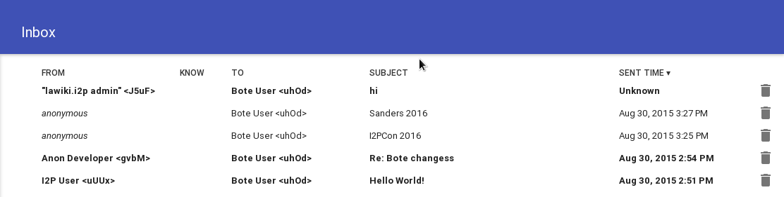
Date Ranges
Find all emails received in a given time.

Slide 7
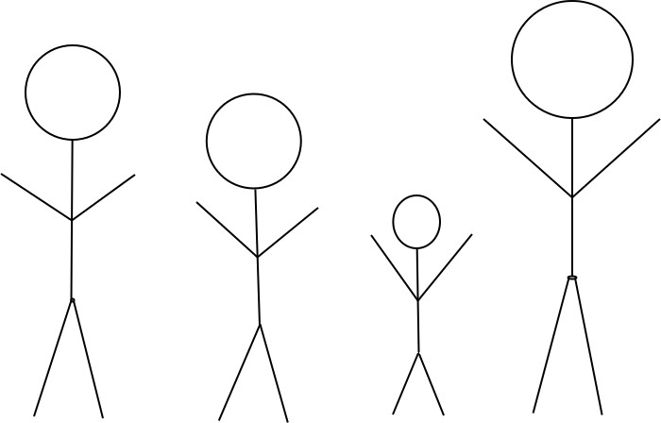
Closest Height Find the person in your class whose height is closest to yours.

Slide 8
Local Search
Definition
A Local Search Data structure stores a number of elements each with a key coming from an ordered set. It supports operations:
Range Search(x , y ): Returns all elements with keys between x and y.
Nearest Neighbors(z):Returns the element with keys on either side of z .

Slide 9
Agenda
Local Search
Examples
Notes:
<number>

Slide 10

Example

Slide 11

Example
RangeSearch(5, 12)

Slide 12

Example
RangeSearch(5, 12)
NearestNeighbors(3)

Slide 13
Dynamic Data Structure
We would also like to be able to modify the data structure as we go.
Insert(x ): Adds a element with key x . Delete(x ): Removes the element with key x .

Slide 14
Example

Slide 15

Example
Insert(3)

Slide 16

Example
Insert(3)
Delete(10)

Slide 17
Problem
If an empty data structure is given these commands what does it output at the end?
Insert(3) Insert(8) Insert(5) Insert(10) Delete(8) Insert(12)
NearestNeighbors(7)

Slide 18

Answer

Slide 19

Array
RangeSearch:
O(n) ×

Slide 20

Array RangeSearch: NearestNeighbors:
O(n) ×
O(n) ×

Slide 21
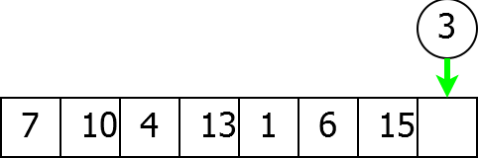
Array RangeSearch: NearestNeighbors: Insert:
O(n) ×
O(n) ×
O(1) C

Slide 22
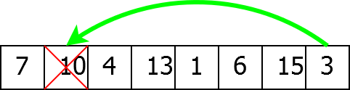
Array
RangeSearch: NearestNeighbors: Insert:
Delete:
O(n) ×
O(n) ×
O(1) C
O(1) C

Slide 23
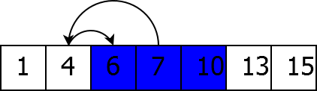
Sorted Array
RangeSearch:
O(log(n)) C

Slide 24
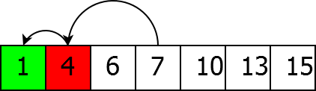
Sorted Array RangeSearch: NearestNeighbors:
O(log(n)) C
O(log(n)) C

Slide 25
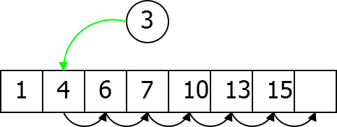
Sorted Array RangeSearch: NearestNeighbors: Insert:
O(log(n)) C
O(log(n)) C
O(n) ×

Slide 26

Sorted Array
RangeSearch: NearestNeighbors: Insert:
Delete:
O(log(n)) C
O(log(n)) C
O(n) ×
O(n) ×

Slide 27
Linked List
RangeSearch:
O(n) ×

Slide 28
Linked List RangeSearch: NearestNeighbors:
O(n) ×
O(n) ×

Slide 29
Linked List RangeSearch: NearestNeighbors: Insert:
O(n) ×
O(n) ×
O(1) C

Slide 30
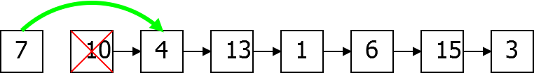
Linked List
RangeSearch: NearestNeighbors: Insert:
Delete:
O(n) ×
O(n) ×
O(1) C
O(1) C

Slide 31
Need Something New
Problem
Previous data structures won’t work. We need something new.
Notes:
<number>

